Slide 1
Lecture 10(A) Sorting

Slide 2
Outline
Introduction and Notation
Insertion Sort
Selection Sort
Shell Sort
----------------
Bucket Sort
Radix Sort
----------------
Divide-and-Conquer Sorting
Mergesort
Quicksort
Heapsort

Slide 3
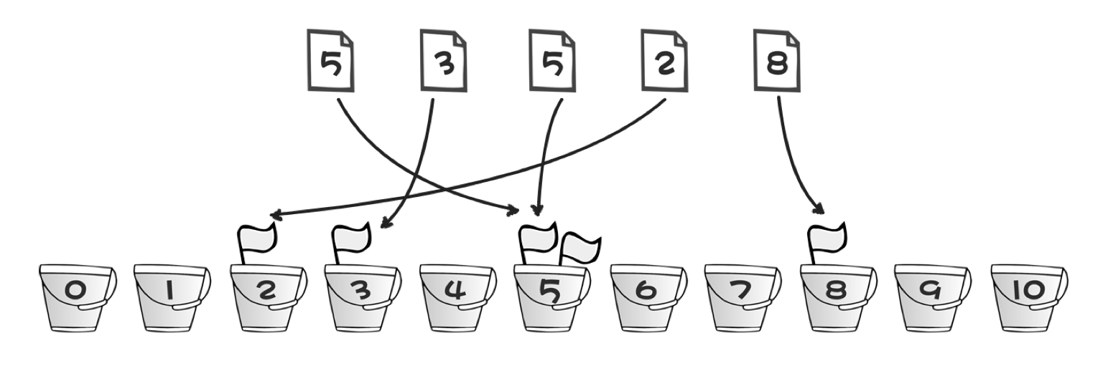
Bucket Sort (桶排序)
Suppose that we have N integers in the range [0, M)
Maintain an array count of size M, which is initialized to zero. Thus, count has M cells (buckets).
Read each integer A_{i}
Increment count[A_{i}] by 1
After all the input array is read, scan the count array, printing out a representation of sorted list.

Slide 4
Radix Sort (基数排序)
Radix sort is a generalization of bucket sort.
It uses several passes of bucket sort.
Type 1: Perform the bucket sorts by “least significant digits” (LSD)
First sort by digit in units place
Second sort by digit in tens place
Third sort by digit in hundreds place
…
Type 2: Perform the bucket sorts by “most significant digits” (MSD)
https://www.geeksforgeeks.org/msd-most-significant-digit-radix-sort/

Slide 5
Radix Sort: Example
Order ten 2 digit numbers in 10 bins from smallest number to largest number. Requires 2 calls to the sort algorithm.
Initial Sequence: 91 6 85 15 92 35 30 22 39
Pass 1: Distribute the cards into bins according to the 1's digit (10⁰).
Sequence after Pass 1: 30 91 92 22 85 15 35 6 39

Slide 6
Radix Sort: Example
Sequence after Pass 1: 30 91 92 22 85 15 35 6 39
Pass 2: Take the new sequence and distribute the cards into bins determined by the 10's digit (10¹).
Final Sequence: 6 15 22 30 35 39 85 91 92

Slide 7
Radix Sort
// 对序列ivec进行 d 位的基数排序
void radixSort(vector<int> &ivec, int d)
{
int i, j, digit = 1;
queue<int> digitQueue[10]; // 10个对应于位的队列
for ( i = 0; i < d; ++i) {
// 将向量中的数依次进入相应位的队列中
for (j = 0; j < ivec.size(); j++)
digitQueue[(ivec[j] / digit) % 10].push(ivec[j]);
// 将队列空间回收，用向量来保存排序后的序列
j = 0;
for (int digitVal = 0; digitVal < 10; ++digitVal)
while (!digitQueue[digitVal].empty())
{
ivec[j] = digitQueue[digitVal].front();
digitQueue[digitVal].pop();
j++;
}
// 每进行一位基数排序，就将中间结果输出显示
cout << "经过第 " << i << "次排序后得到的序列：" << endl;
for ( j = 0; j < ivec.size(); ++j)
cout << ivec[j] << " ";
cout << endl;
// 从个位数开始，直到第d位数
digit *= 10;
}
}

Slide 8

Thank you!

